Slide 1


Introduction
Title: Strategic Growth Plan for Company XYZ
Company XYZ is a defense solutions company specializing in vehicle armouring. This presentation outlines a comprehensive strategic growth plan to achieve a $1 billion valuation within the next decade.
by Israel Josiah

Slide 2
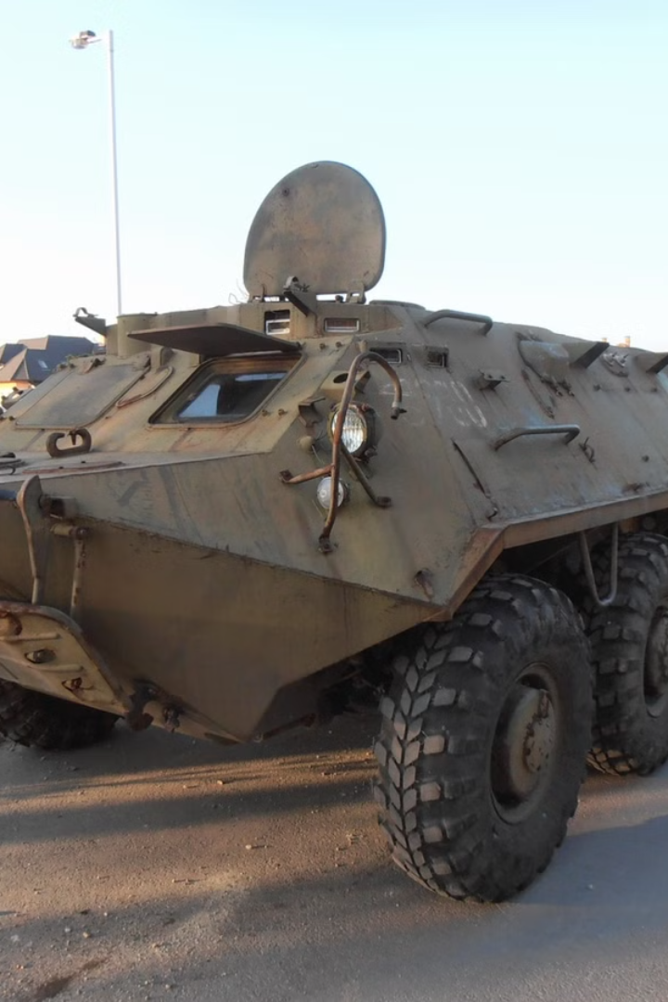
Executive Summary
Current State.
XYZ is valued at $100 million with a 15% EBITDA margin. Key strengths include innovation and a skilled workforce, but challenges include process inefficiencies, supply chain constraints, and resistance to change.
Key Takeaway
By leveraging its core strengths and addressing its challenges with a structured roadmap, XYZ can solidify its position as an industry leader.
Strategic Goals.
This plan outlines a detailed market analysis, strategic recommendations, financial projections, and implementation methodologies to achieve a $1 billion valuation within the next decade.

Slide 3
Industry Overview
01
02
03
04
Global Market
Key Drivers
Regional Highlights
Segments
The global armored vehicle market is currently valued at $27 billion and is projected to grow at a CAGR of 5.4%.
Increasing defense budgets, geopolitical tensions, and technological advancements are driving market growth.
North America, Europe and Middle East are the largest market, while APAC is the fastest-growing region.
The market includes military vehicles, Light Armored Vehicles (LAV). civilian armored vehicles, and VIP vehicles.

Slide 4

Competitive Analysis
General Dynamics Land Systems
Kalyani Strategic Systems Ltd
BAE Systems
Known for its Stryker vehicles, General Dynamics emphasizes collaboration with military clients to understand their needs better. This customer-centric approach has led to successful contracts and innovations. XYZ can adopt similar strategies by engaging with potential clients early in the development process.
Market leader with high R&D spending and a robust product line. Revenue: $3 billion.
BAE has successfully integrated advanced technologies into its armored vehicles. Their focus on innovation and employee training has enabled them to stay competitive. XYZ can learn from BAE’s approach to employee engagement and technological investment.

Slide 5
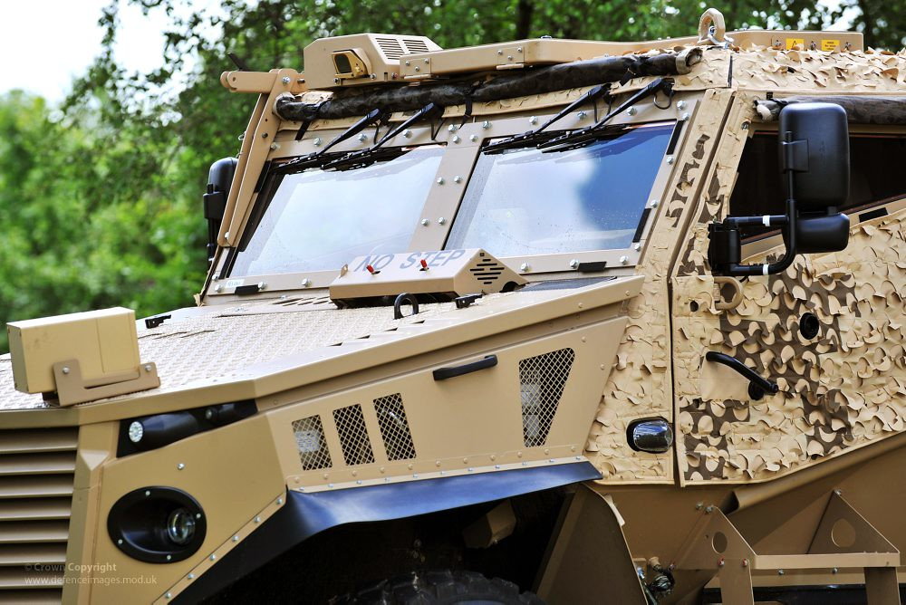
Insights & Opportunities
Defense Spending Growth
Global defense spending is projected to reach approximately $2 trillion by 2026, with a significant portion allocated to armored vehicles. Countries like India, China, and those in Eastern Europe are increasing their budgets, presenting opportunities for XYZ
Comparative Insights
XYZ's innovation strength gives it an edge in developing cutting-edge materials and technologies, but it lags in market penetration and supply chain resilience, compared to competitors.
Opportunities for Differentiation
XYZ can target emerging markets, there is high demand in regions like the Middle East and Southeast Asia due to increased defense spending, develop specialized armoring solutions by focusing on hybrid and autonomous vehicles, leveraging sustainability trends, and form strategic partnerships with governments and technology providers to strengthen R&D.

Slide 6




Industry Trends and Opportunities
Autonomous Vehicles
Strategic Partnerships
The development of autonomous and hybrid armoured vehicles presents a significant opportunity for growth.
Partnerships with governments for R&D funding can accelerate innovation and market penetration.
Sustainable Solutions
Developing sustainable armoured vehicles aligns with global trends and attracts environmentally conscious customers.

Slide 7
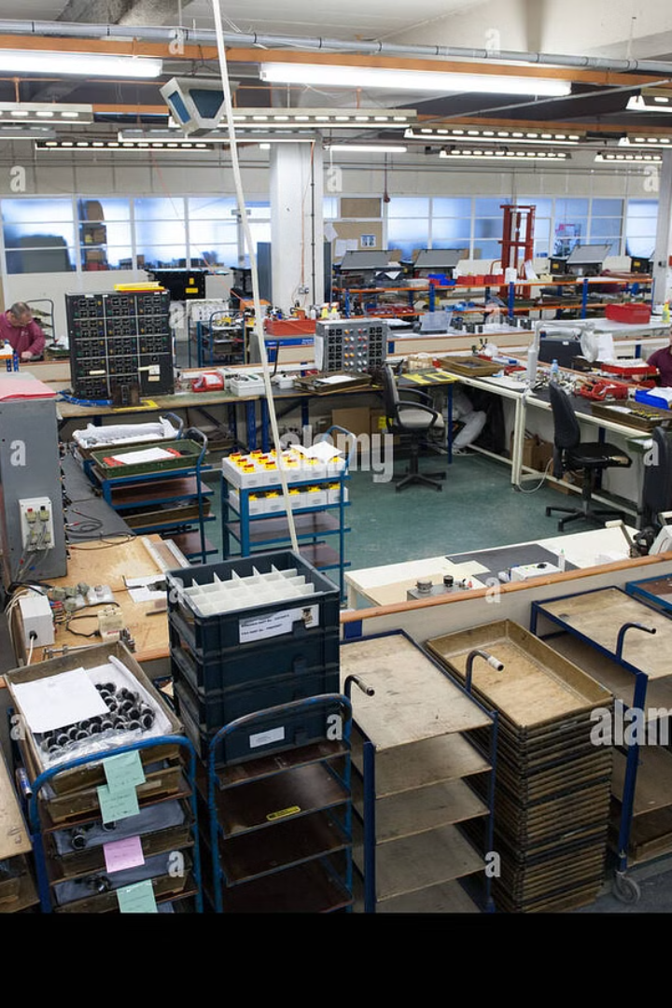
Challenges Analysis
1
Process Optimization
Current State: Lack of streamlined workflows leads to delays and inefficiencies in production.
Impact: Increased operational costs and reduced output.
Proposed Solution: Implement Lean and Six Sigma practices to standardize processes and eliminate waste.
2
Supply Chain Issues
Current State: Dependence on a limited number of suppliers creates bottlenecks.
Impact: Vulnerability to global disruptions and material shortages.
Proposed Solution: Diversify supplier base and adopt predictive analytics for demand forecasting.
3
Employee Resistance to Change
Current State: Resistance stems from fear of role displacement and lack of training in new technologies.
Impact: Slows adoption of innovative practices and reduces morale.
Proposed Solution: Implement the ADKAR model for change management and conduct regular upskilling programs.

Slide 8




Strategic Recommendations
Process Optimization
Automate repetitive tasks with AI-driven solutions, develop a central dashboard for monitoring KPIs across departments, and regularly review and iterate workflows through feedback loops.
Enhance Supply Chain Efficiency
Establish relationships with local and international suppliers to reduce dependency on a few sources, integrate a cloud-based supply chain management system for real-time tracking, and invest in bulk purchasing to negotiate better pricing and reduce costs.
Cultural Change Management
Foster a culture of collaboration and innovation by introducing employee reward systems for adopting new practices, conduct leadership training to ensure managers model the desired behaviors, and roll out an internal communication campaign emphasizing the benefits of transformation.

Slide 9

Process Optimization
Lean Manufacturing
Optimize Inventory management by implementing lean principles to reduce waste and improve efficiency in production processes. This can help in cost reduction and faster delivery times
Digital Transformation
Invest in digital tools like ERP systems to streamline operations and enhance supply chain management.
AI Driven Automation
Automate repetitive tasks with AI-driven solutions, develop a central dashboard for monitoring KPIs across departments, and regularly review and iterate workflows through feedback loops.

Slide 10
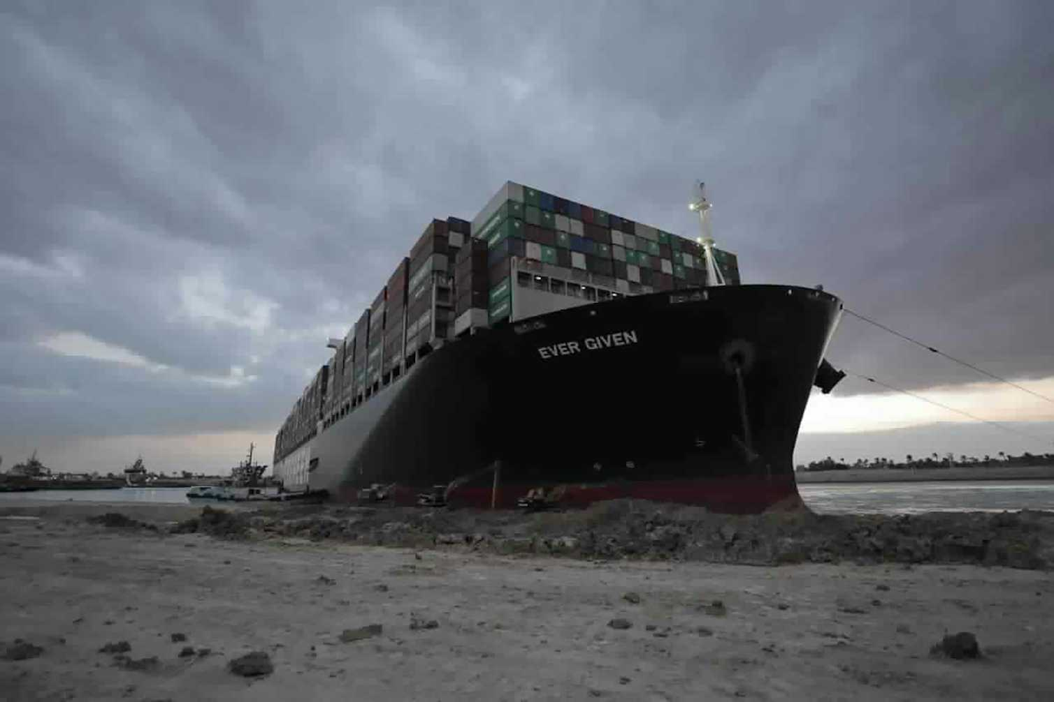
Enhancing Supply Chain Efficiency
Diversification
Strengthen supplier relationships and diversify as over-reliance on a single supplier increases risks. Build a diversified supplier base to mitigate risks associated with supply chain disruptions
Local Sourcing
Consider local suppliers to reduce lead times and transportation costs, especially for critical components.
Streamline Inventory Management
Use technology like barcode scanners or RFID systems to track inventory in real-time. This reduces errors, ensures you have the right stock levels, and avoids delays in production or delivery

Slide 11

Cultural Change Management
Employee Engagement Programs
Foster a culture of innovation by involving employees in decision-making processes and encouraging feedback on new initiatives
Training and Development
Offer hands-on training and resources to help employees adapt to new technologies or processes. Ensure they have access to support if they encounter issues, Implement training programs that focus on new technologies and methodologies to ease resistance to change
Monitor and Adjust
Continuously collect feedback from staff and evaluate the effectiveness of the changes. Make adjustments as needed to ensure the transition is smooth and successful.

Slide 12
Methodologies and Frameworks
SWOT Analysis
Balanced Scorecard (BSC)
To identify XYZ's strengths, weaknesses, opportunities, and threats. This will provide a clear picture of the internal and external factors influencing growth
Strategically plan and drive business activities towards the vision and strategy of the organization, improve internal and external communications, and monitor organizational performance against strategic goals.
Risk Management Framework
Lean Six Sigma
Implementing Lean Six Sigma can lead to significant cost savings and improved product quality, which is crucial for maintaining competitiveness in the armored vehicle market.
A risk management strategy will address potential challenges, including supply chain disruptions and market volatility
Stakeholder Engagement
Agile Methodology
The importance of engaging stakeholders (employees, customers, suppliers) throughout the transformation process helps to foster buy-in and reduce resistance to change
Agile can help XYZ respond swiftly to market changes and customer needs, enhancing its ability to innovate and adapt

Slide 13
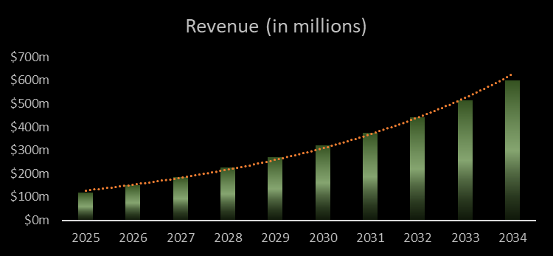
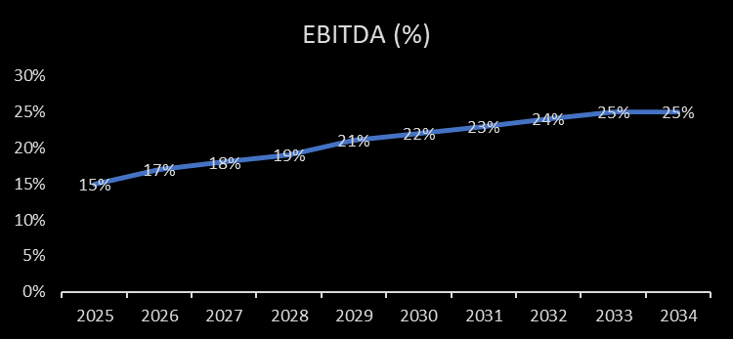
Financial Projections
22%
25%
Revenue Growth
EBITDA Improvements
Target a CAGR of 22% to achieve $1 billion in valuation.
Increase EBITDA from 15% to 25% by year 10 through operational efficiencies and supply chain optimizations.
$50M
10%
Market Expansion
Cost Savings
Dedicate $50 million over five years to enter high-growth regions.
Achieve 10% annual savings through Lean manufacturing and bulk material sourcing.

Slide 14
Revenue Growth Strategy (22% CAGR)
Strategies in Achieving Financial Projection
Cost Optimization Strategy (25% EBITDA)
Expand Market Reach
Process Optimization
Target Emerging Markets regions like the Middle East, Southeast Asia, and Africa and establish local partnerships.
Lean Six Sigma Implementation: Streamline production processes to eliminate waste & invest in ERP Systems
Government & Military Contracts
Supply Chain Efficiency
Actively bid for exclusive, high-value government contracts. And build long-term relationships with defense agencies
01
02
Mitigate risks by partnering with multiple suppliers and local vendors to reduce material costs and lead times.
08
03
Boost Product Innovation & R&D
07
04
Reduce Operational Overheads
Allocate R&D Budget (5–7% of Revenue) to develop technologies like lightweight materials & AI-enabled systems
06
05
Transition to energy-efficient production methods to reduce utility costs.
Optimize Pricing Strategy
Workforce & Culture Development
Value-Based Pricing: Align prices with the unique value offered by XYZ’s products compared to competitors.
Regularly train employees on the latest manufacturing and software tools to enhance productivity.

Slide 15
Implementation Roadmap
Long-Term Goals
Mid-Term Goals
Achieve industry leadership in innovation and diversify product offerings.
Short-Term Goals
Expand into high-growth markets and form strategic alliances.
Address supply chain bottlenecks, launch change management programs, and invest in product differentiation R&D.
Simulation
Analysis
Results

Slide 16

Conclusion and Call to Action
This strategic plan outlines a comprehensive roadmap for Company XYZ's ambitious growth goals. By implementing the proposed strategies, XYZ can solidify its position as an industry leader and achieve a $1 billion valuation within the next decade. The call to action is to approve the proposed strategies, commit to fostering a culture of collaboration and innovation, and execute the plan.

